Slide 1


Your Dining Assistant
@ Georgia Tech
Buzz ingo! Meal
Qi Zheng & Luoyin Feng
CS 6365 -- Intro to Enterprise Computing 04-13-2017

Slide 2
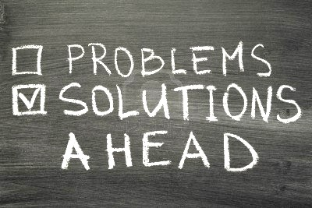
Main Issues
Scattered food Info
Inconvenient access to menus
Unaware of nutrition facts, hard to keep track of calorie/nutrition intake
Don’t know where to go
Diet management
Notes:
From Objectives to Functionalities

Slide 3
Functionalities
Real-Time menus for all dining places across the campus
Detailed nutrition facts
Precise locations + Easy Navigation
Diet management:
Nutrient Density Scores based on NRF profiling
Daily Value Suggestions
Calorie Intake Calculator
Notes:
From Objectives to Functionalities

Slide 4

Technology Overview
Web crawling and scraping→ Data & Contents
(Python: Urllib + BeautifulSoup; Selenium + Phantomjs)
Web server and application with RESTful API → Backend Service
(Python + Flask)
Android App → Client (Mobile) End
(Android 7)

Slide 5

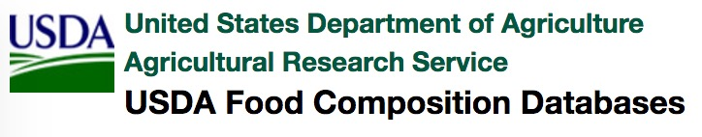
Data Collection and Intergradation
> 1,800 records
Menu Item
Item ID
Day in Week
Time in Day
Meal Serving Size
Total Calories
Calories from Fat
Total Fat(g)
Saturated Fat(g)
Trans Fat
Cholesterol(mg)
Sodium(mg)
Total Carbohydrates(g)
Dietary Fiber(g)
Sugars (g)
Protein(g)
Potassium
Magnesium
Vitamin A
Vitamin C
Vitamin E
Calcium
Iron
Special Info
Notes:
From Objectives to Functionalities

Slide 6
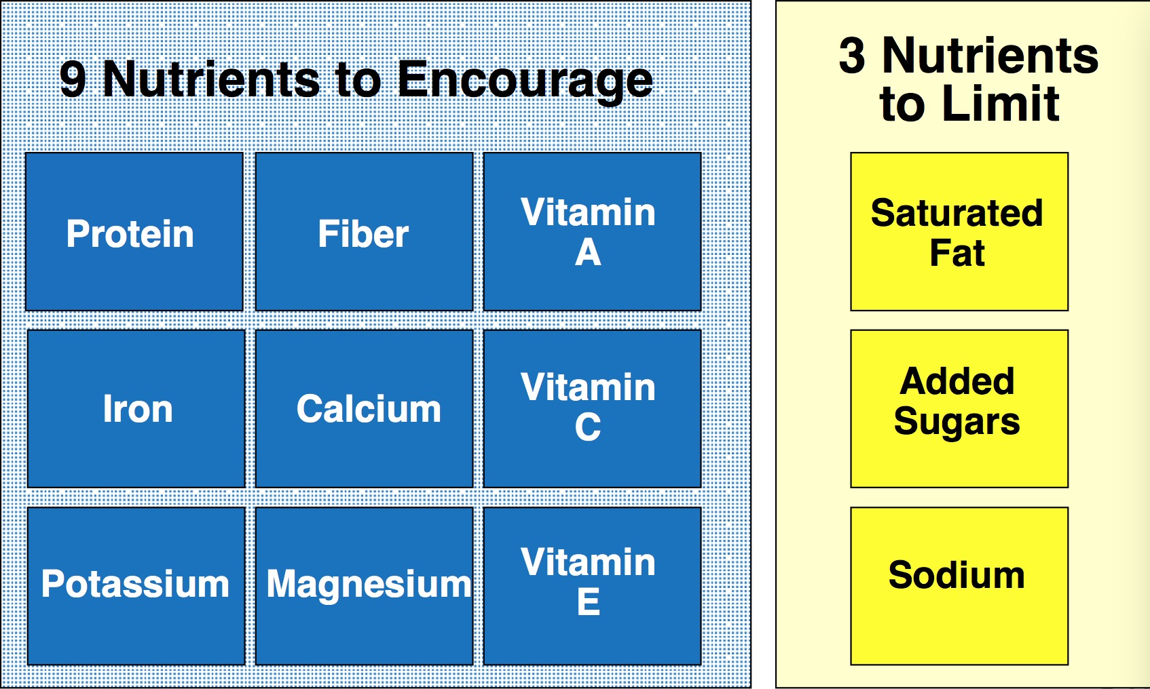
Nutrient Profiling
Algorithm
Scores:
1-10
References
Drewnowski, Adam. "The Nutrient Rich Foods Index helps to identify healthy, affordable foods." The American journal of clinical nutrition 91.4 (2010): 1095S-1101S.
Fulgoni, Victor L., Debra R. Keast, and Adam Drewnowski. "Development and validation of the nutrient-rich foods index: a tool to measure nutritional quality of foods." The Journal of nutrition 139.8 (2009): 1549-1554.
Notes:
The Nutrition Facts Panel stresses individual nutrients, rather than the total nutrient package. Also, it may be too complex, that people end up only looking at the total calories. So we want to rank foods based on their nutrient composition, Each food is assigned a unitary score that best reflects its nutrient quality.
FDA defines + Dietary Guidelines seven for Americas

Slide 7
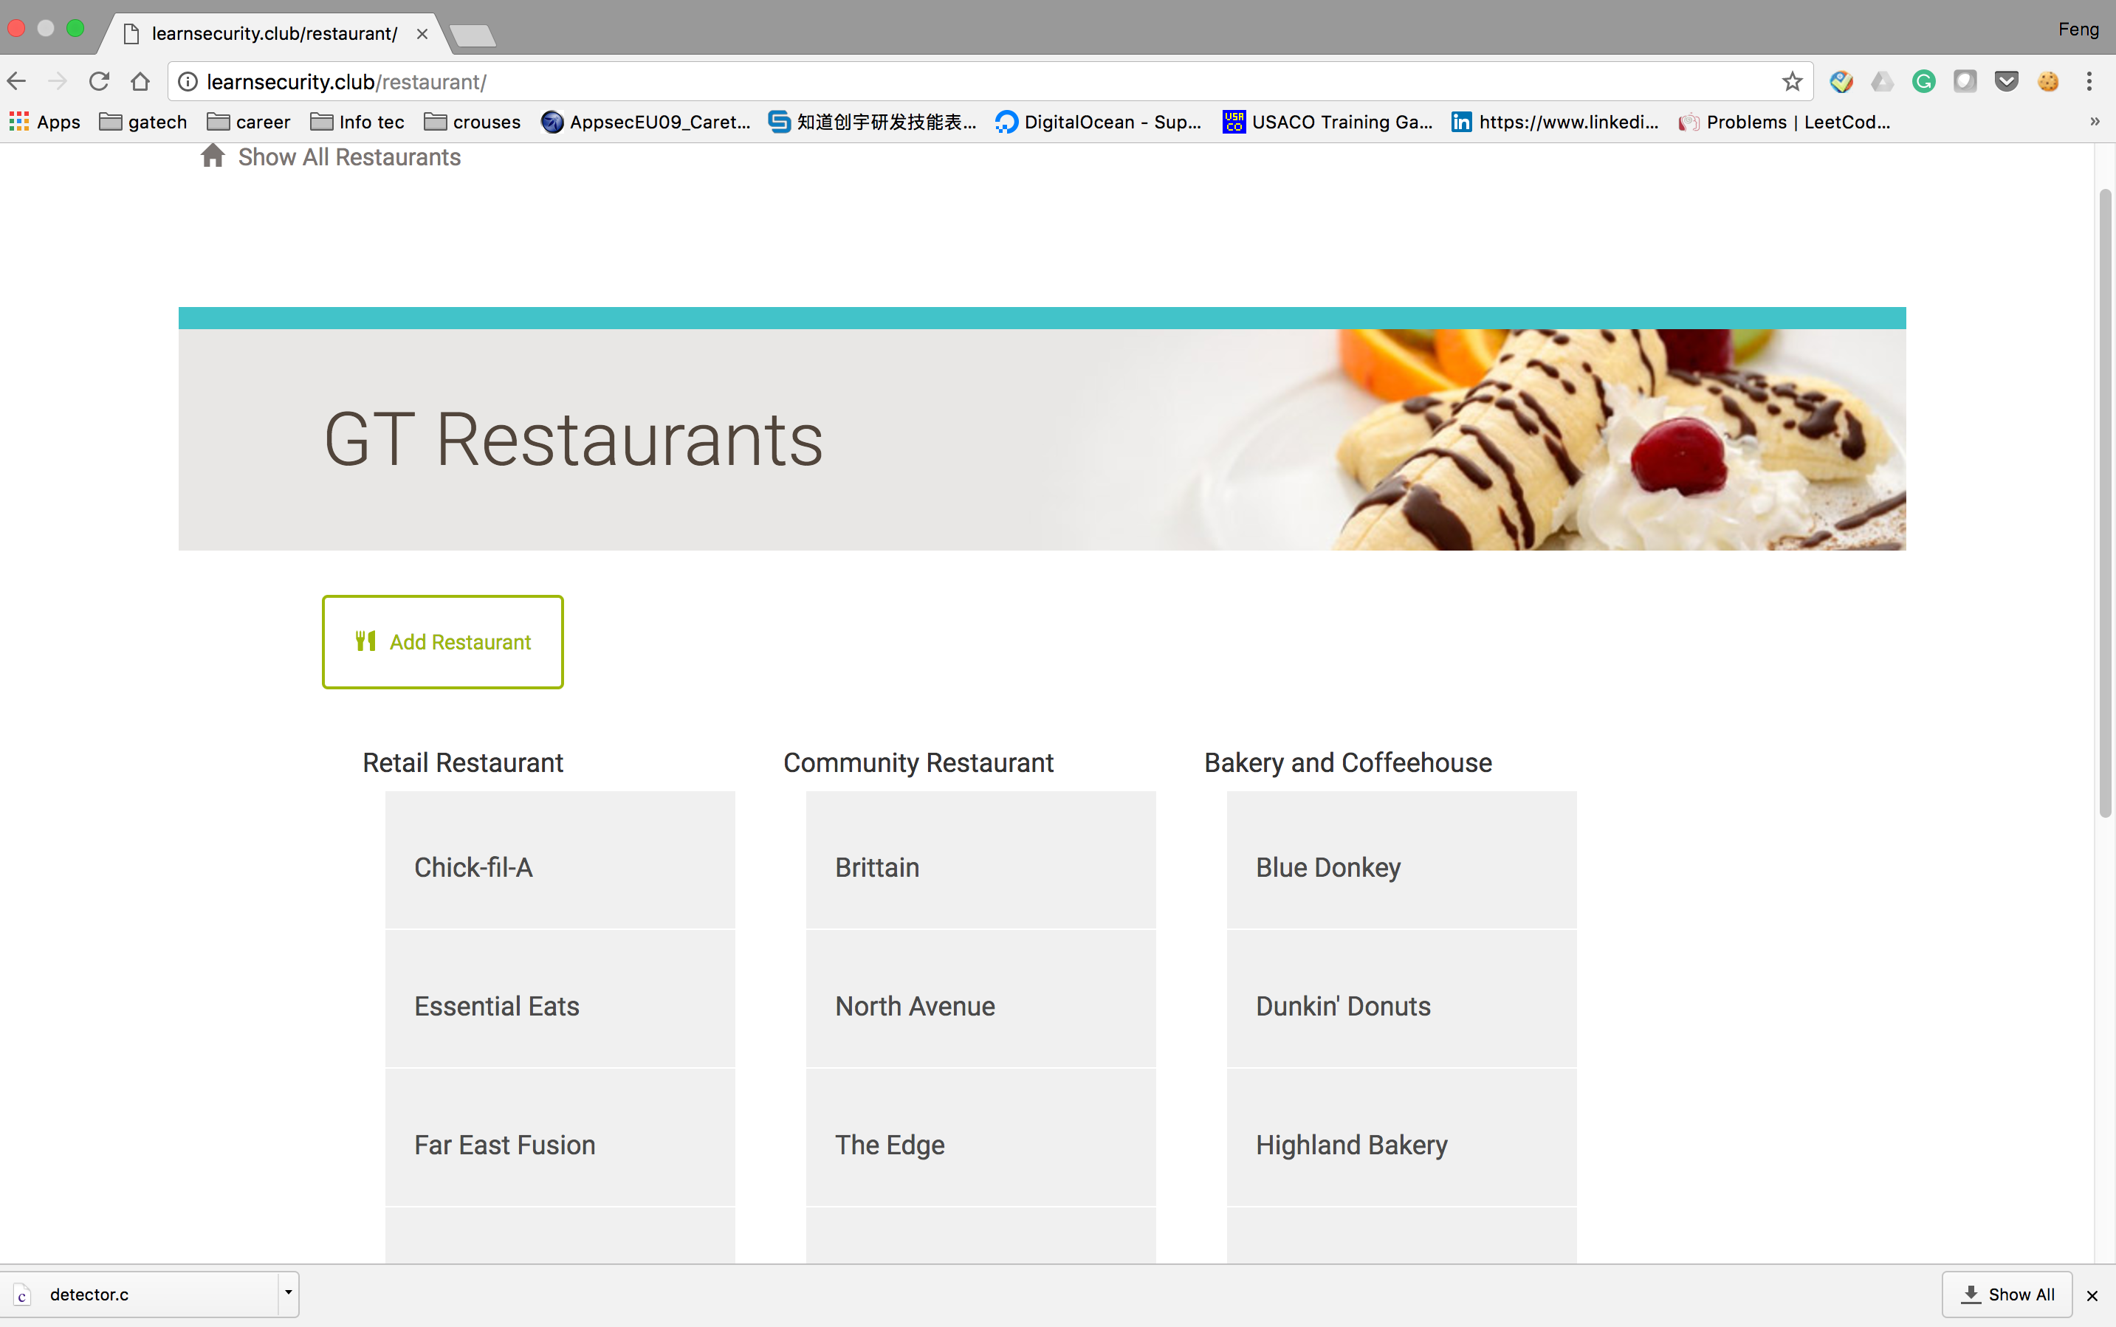
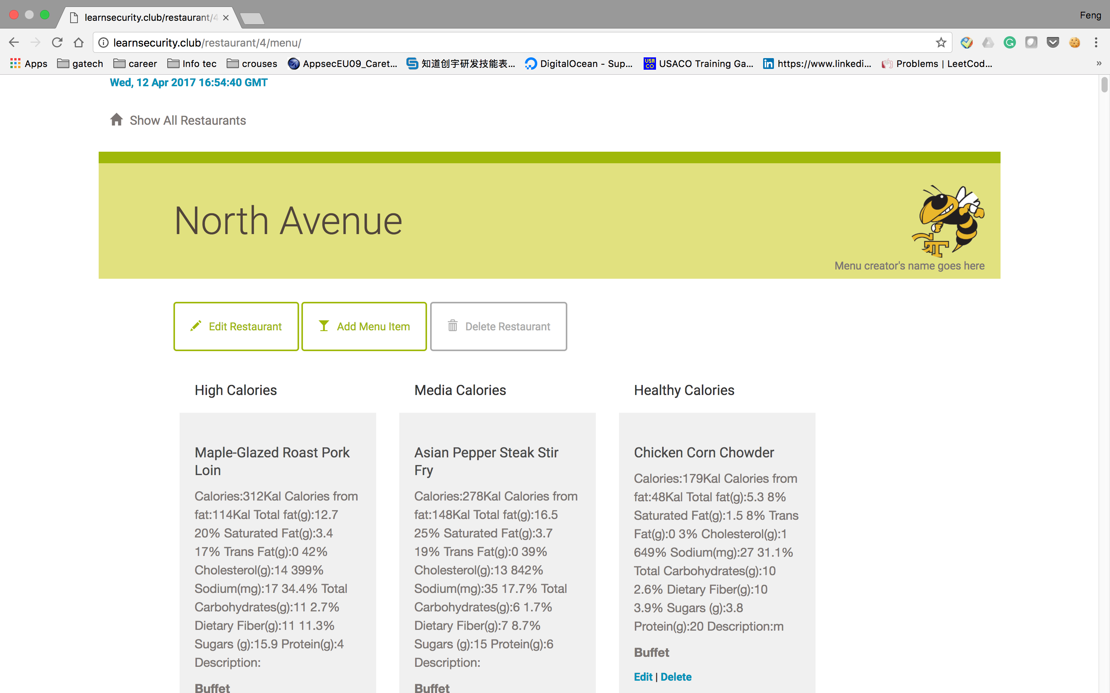
Web App
Notes:
From Objectives to Functionalities

Slide 8
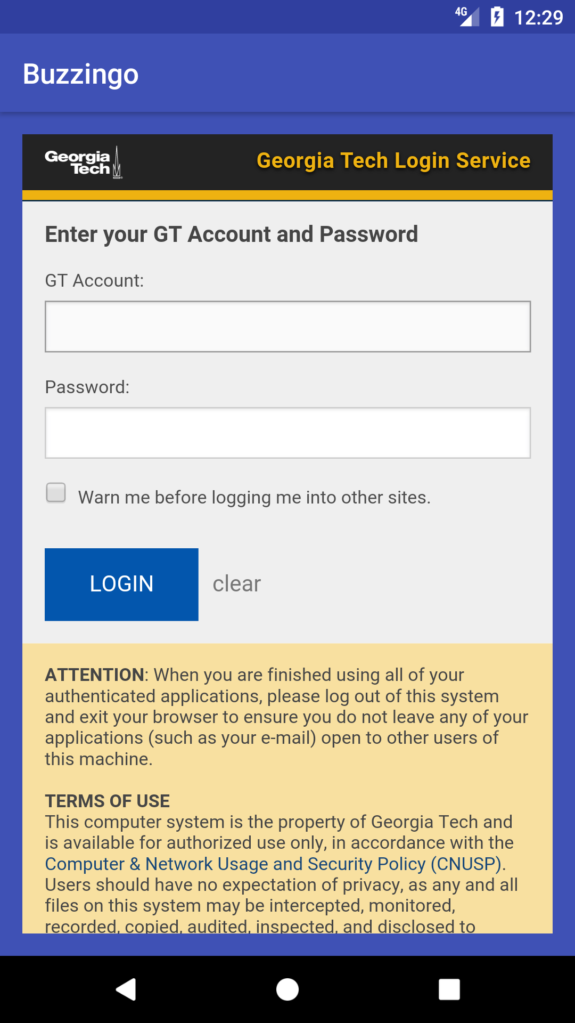
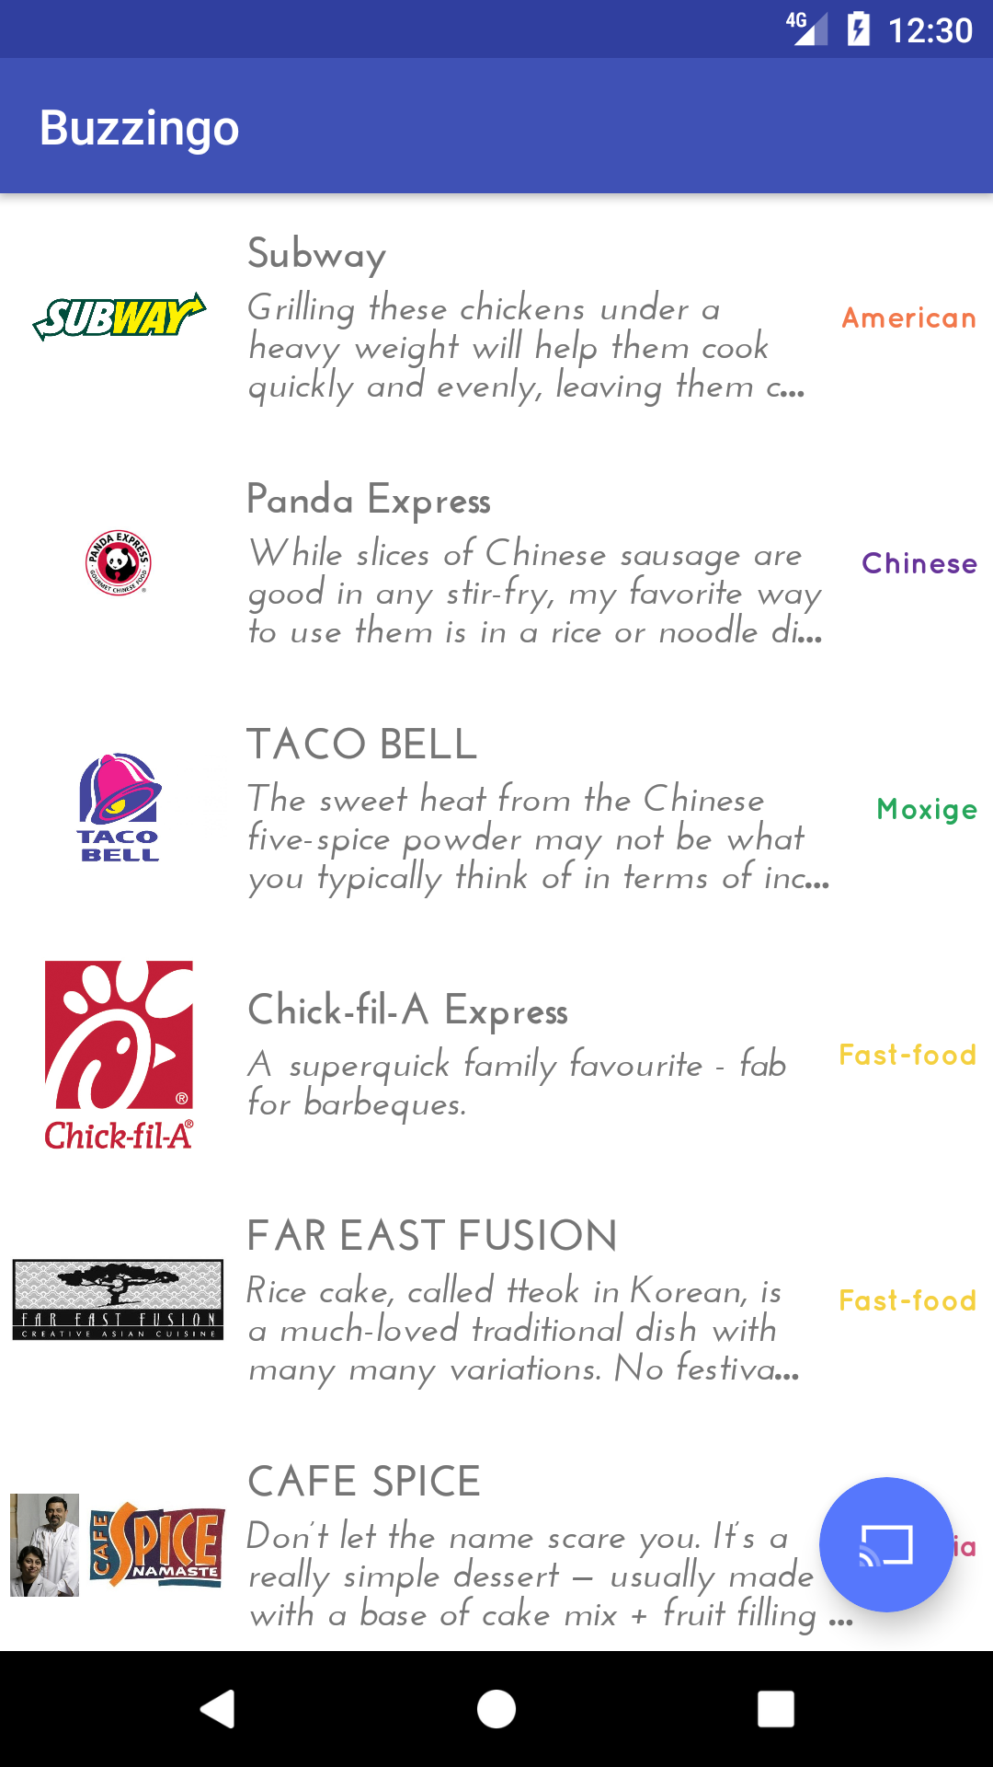
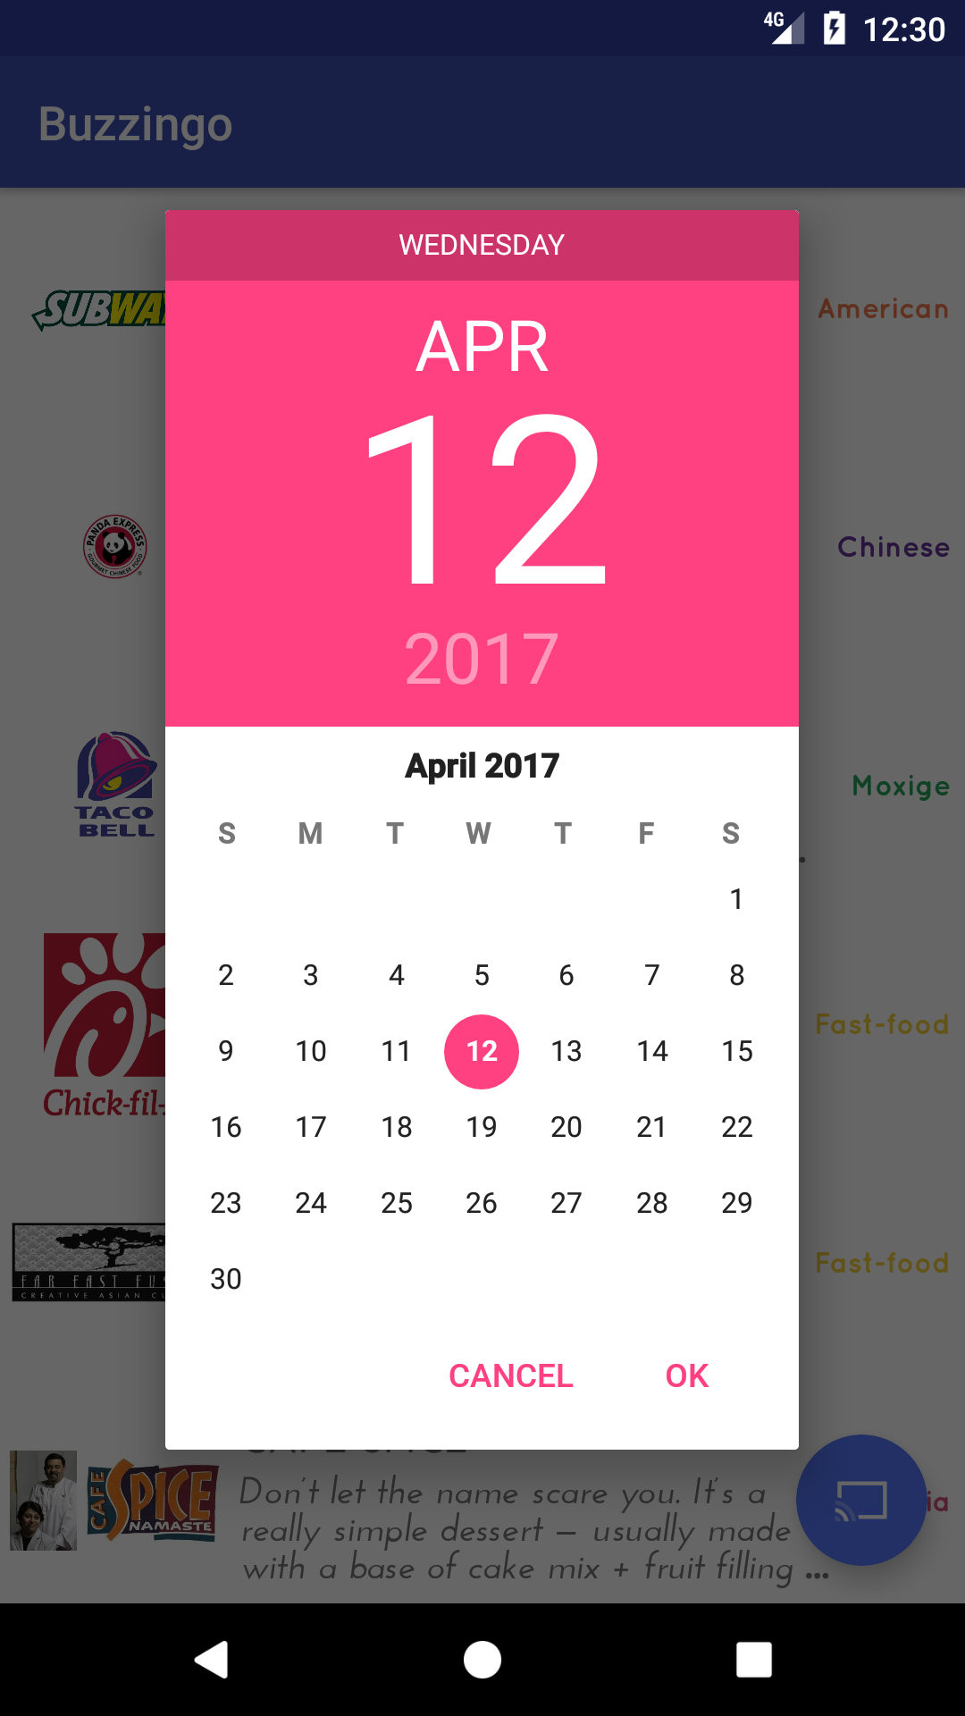
Android App Design
Notes:
From Objectives to Functionalities

Slide 9
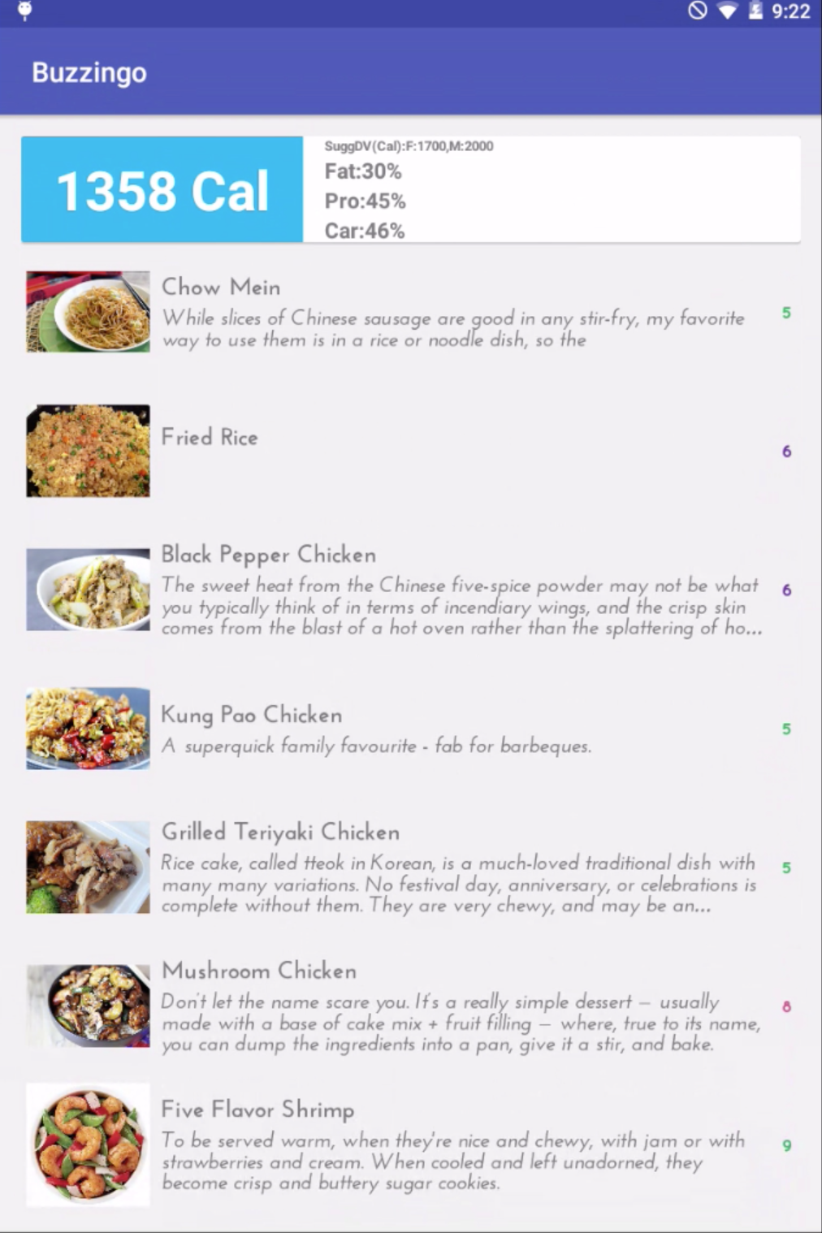
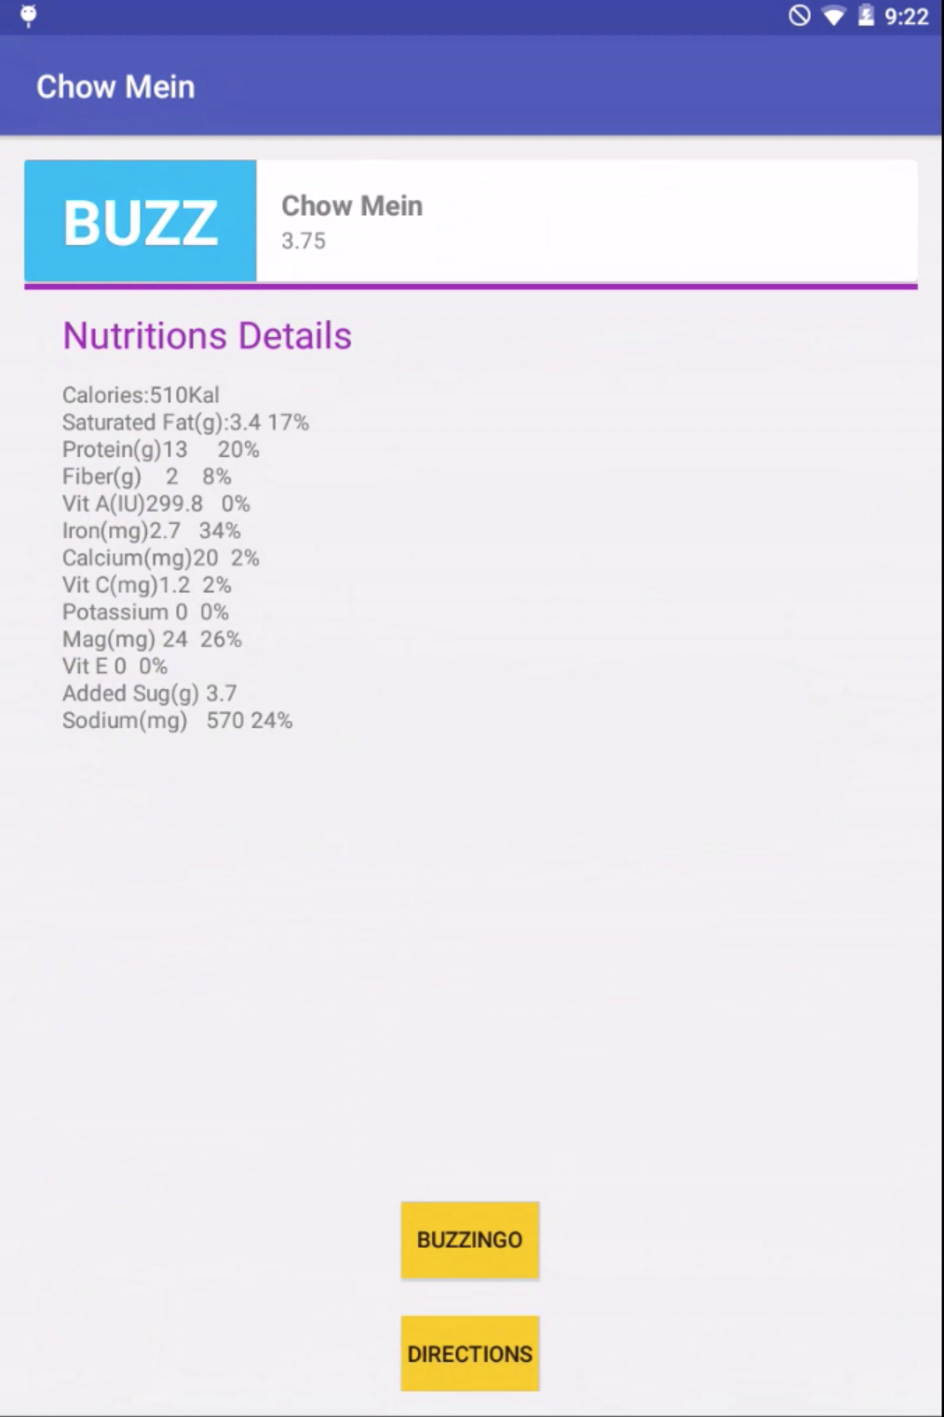
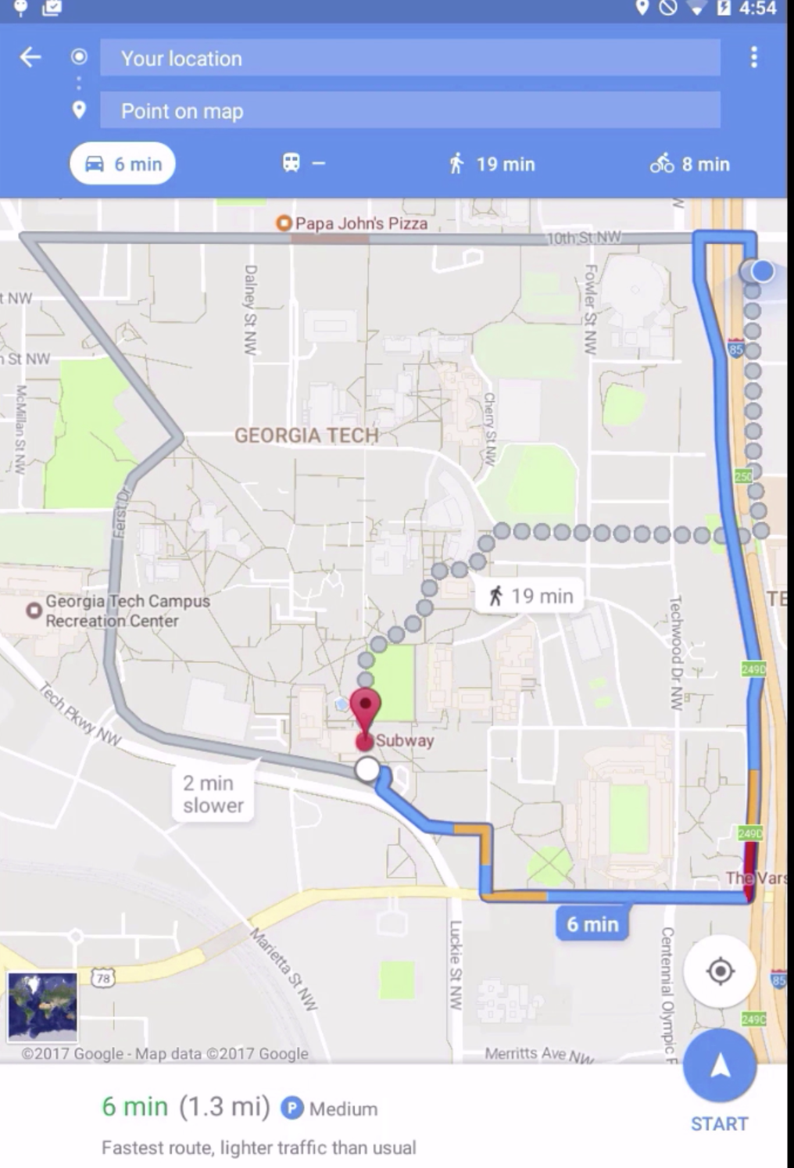
Android App Design (Cont.)

Slide 10
Demo and User Cases

Slide 11
Q & A
CS 6365 -- Intro to Enterprise Computing 04-13-2017

